Slide 1
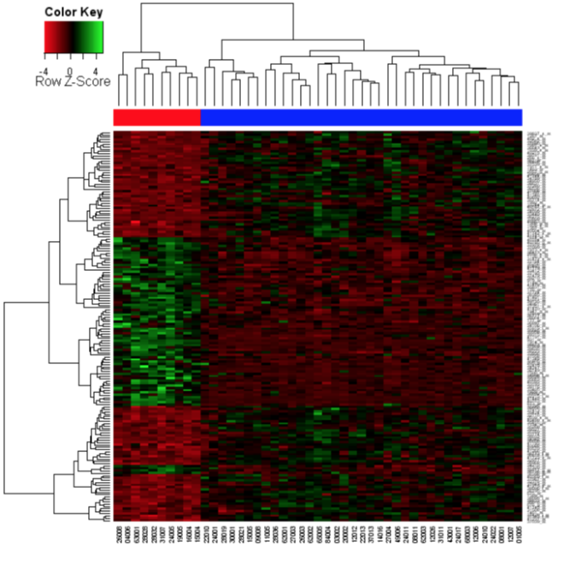
Data Visualisation using Heatmaps in R
Notes:
A lot of the data we deal with is high throughput where we look at the expression levels of thousands of genes across multiple samples
A common method of visualising such data is to display it as a heatmap
A heat map is a graphical two-dimensional representation of data
The columns within a heat map might represent different samples while the rows might represent different genes, the values associated with each of these genes within the particular samples are represented in color.
The heatmap may also be combined with clustering methods which group genes and/or samples together based on the similarity of their gene expression pattern. This can be useful for identifying genes that are commonly regulated, or biological signatures associated with a particular condition (e.g a disease or an environmental condition)

Slide 2
Heatmaps in R
Several packages available…
Heatmap
Heatmap.2
aheatmap (NMF)
Heatmaply (interactive heatmap)
Pheatmap
Notes:
Pheatmap is a package for drawing pretty heatmaps in R. The ordinary heatmap function in R has several drawbacks when it comes to producing publication quality heatmaps. It is hard to produce pictures with consistent text, cell and overall sizes and shapes. The function pheatmap tries to alleviate the problems by offering more fine grained control over heatmap dimensions and appearance.

Slide 3
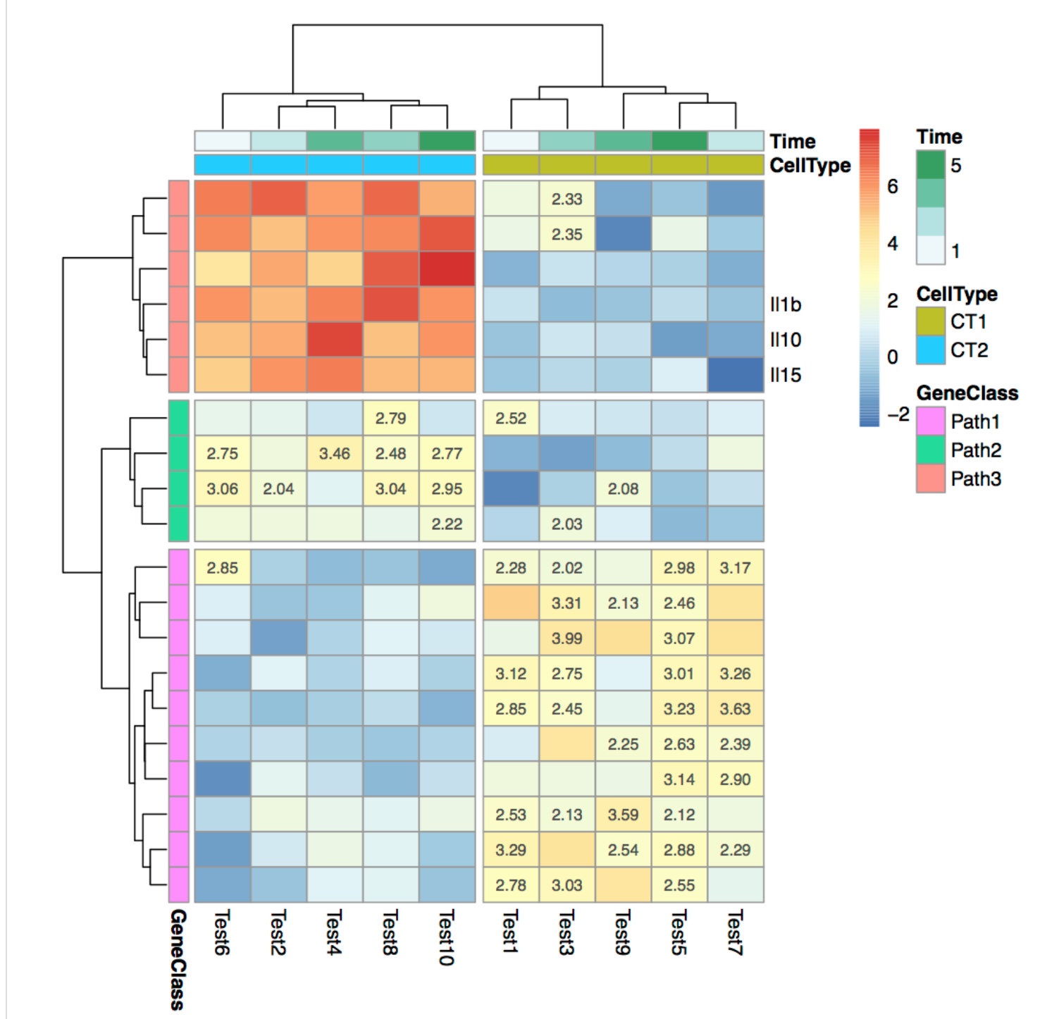
Pheatmap
Features:
Very easy to use!
Offers a lot of control over heatmap dimensions and appearance
Easily add row and column annotations
Great for publication quality heatmaps

Slide 4
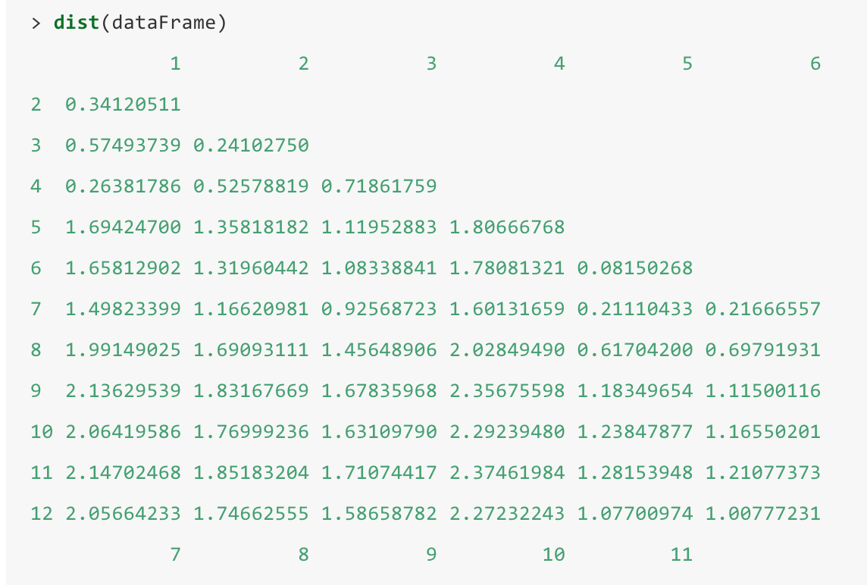
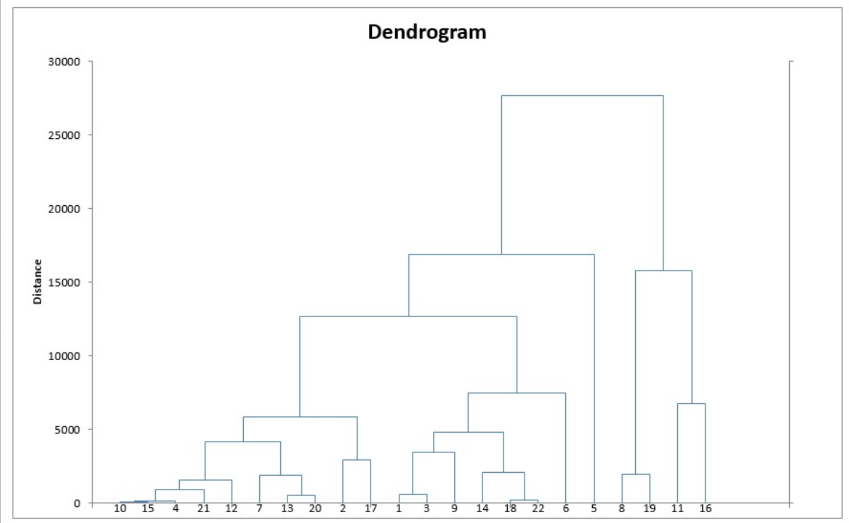
How does the clustering work?
1. Calculate a Pairwise Distance Matrix
dist function;
Default distance metric: Euclidean
2. Hierarchial clustering
hclust function
Default method for joining groups: “complete”
Notes:
Clustering is commonly used for visualizing high dimensional or multidimensional data, organising your data into groups that are most similar to each other
There are many different types of clustering algorithms but Pheatmap uses hierarchial clustering approach using the hclust algorithm so I will very briefly explain it.
Hierarchical clustering involves organizing your data into a kind of hierarchy. The most common approach is called an agglomerative approach
In a nutshell, Hierarchial clustering works by first calculating the pairwise distance between all points in your dataset.
It then joins the data points that are the least distant apart; then it joins the next least distant pair of points; etc etc until it has joined all points.
The tree is a graphical representation of this process.

Slide 5
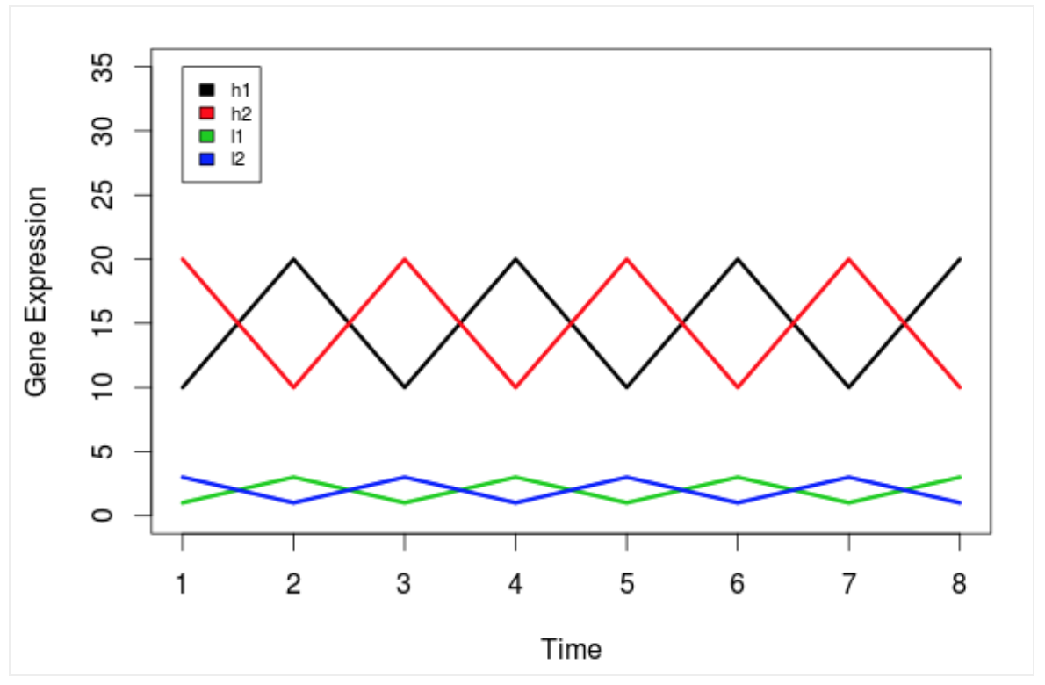
Which distance measure to use?
Possible values in Pheatmap:
“Correlation” and all distances supported by dist including “euclidean”
Euclidean distance
Correlation distance
Opiniomics blog by Mick Watson
Notes:
In pheatmap, the distance measure is calculated using the dist() function, whose own default is euclidean distance.
This measures the absolute distance between the points in space
Which to use?
Heres a simple illustration to explain this.
So we have two highly expressed genes and two lowly expressed genes. But also we have, the two pairs of genes (high and low) have very different shapes.
How do we want to cluster them?
Do we want to cluster all highly expressed genes together and similarly all lowly expressed genes together?
OR
Do we want to cluster by the shape of the data, genes which share the same expression profile (no matter what level of expression) should be clustered together.
Depending on which question, we choose a different distance measure.
Euclidean measures the absolute distance between the points so allows us to cluster on expression level
With correlation, we can cluster on shape. Here h1 and l1 vectors are correlated to each other so are clustered together and h2 and l2 are clustered together.

Slide 6
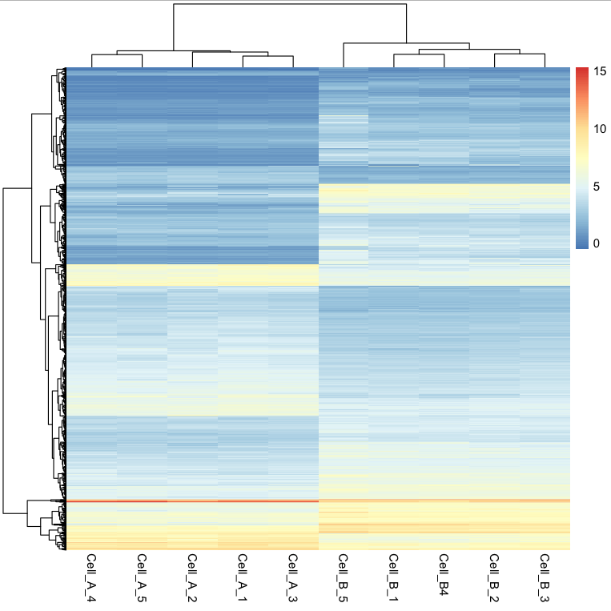
How is the matrix converted into a colour?
Raw data
* log normalised read counts

Slide 7
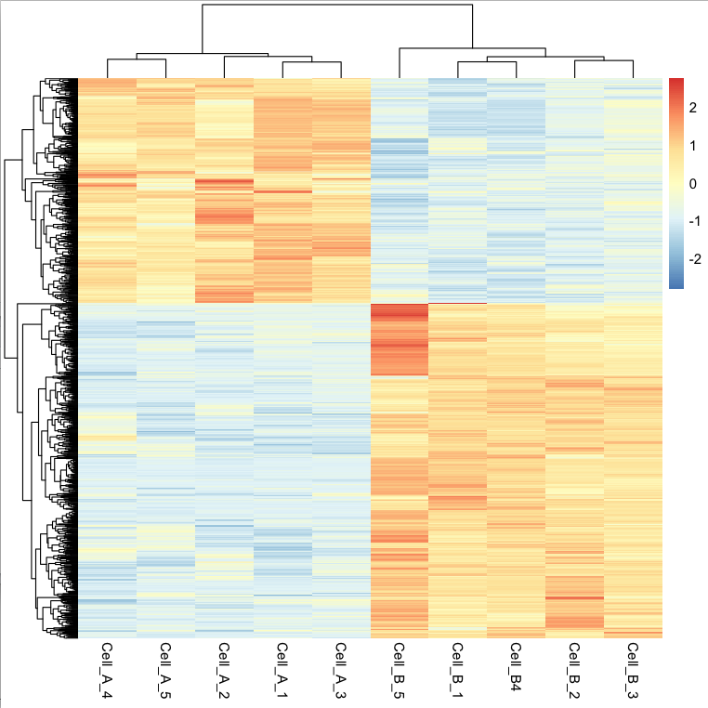
How is the matrix converted into a colour?
Raw data
Scaled data
* log normalised read counts
Notes:
Once we add scaling, this is what we want - genes clustered on the shape of their expression profile

